Slide 1
Thursday
1
26.03.2020

Slide 2
1. Read and colour.
purple
blue
orange
yellow
white
red
green
black
brown
pink

Slide 3
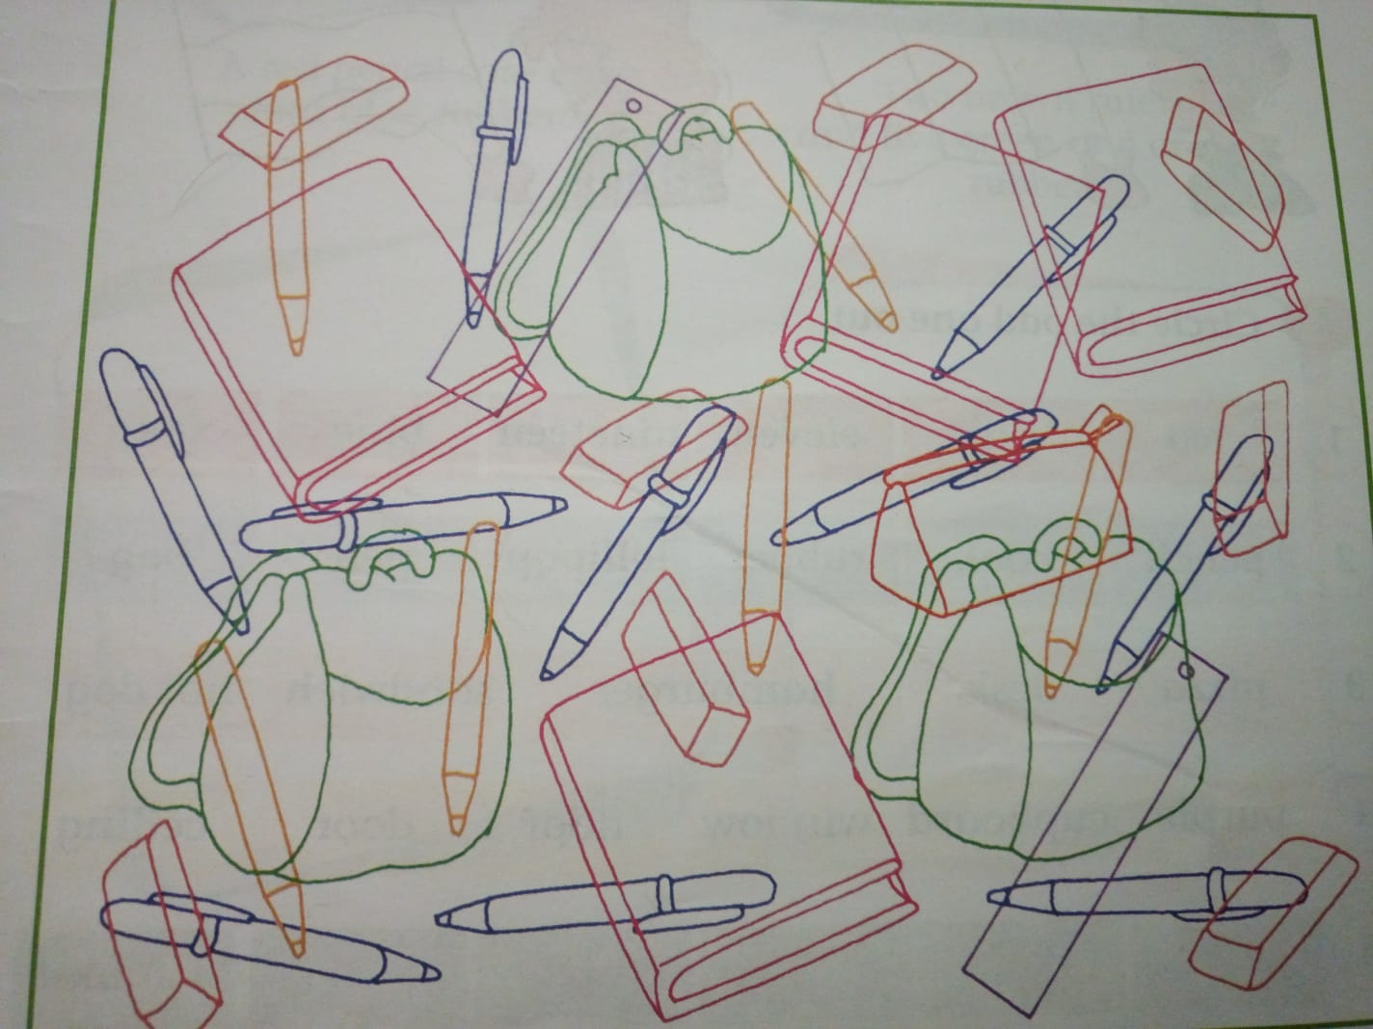
2. Count and write. Ex . three bags

Slide 4
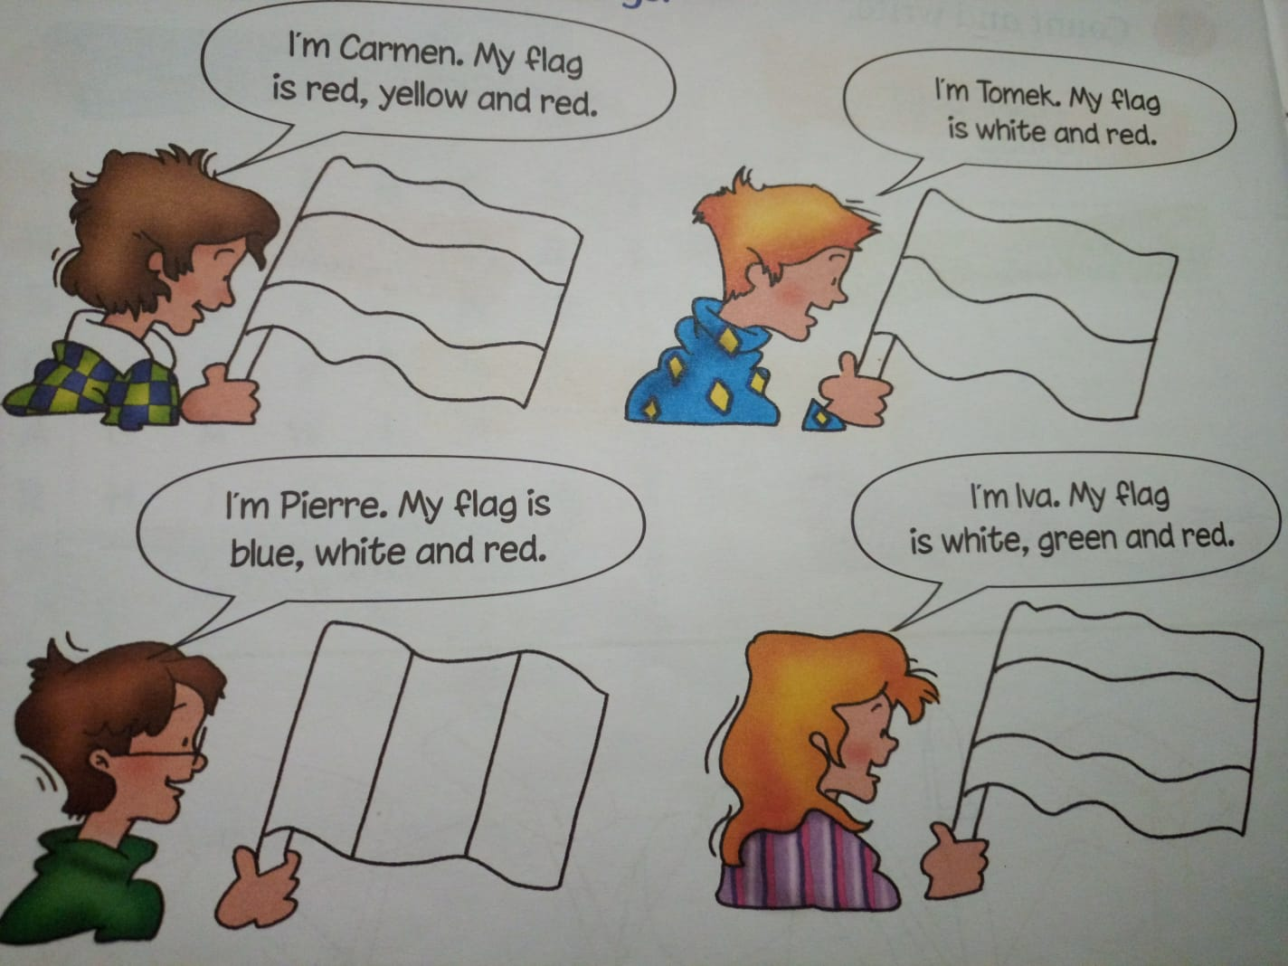
3. Read and colour the flags.

